Slide 1
DATA209: Advanced Exploratory Data Analysis
BTech Hons Data Science | School of Engineering and Technology
Semester III | 4 Credits | 2:0:4 LTP

Slide 2
Course Overview
Duration: 15 weeks
Contact Hours: 6 hours per week (2 lecture + 4 practical)
Total Credits: 4 (2:0:4 LTP)
Prerequisites: Data Visualization and story Telling (DATA132), Probability and Statistics (MATH203)
Target Audience: BTech Hons Data Science students (Semester III)
Teaching Mode: Blended (classroom + hands-on lab sessions)

Slide 3
Course Description & Objectives
Course Aim:
Advanced Exploratory Data Analysis (EDA) equips students with sophisticated techniques to uncover patterns, relationships, and insights from complex datasets. This course bridges foundational data science with advanced analytical methodologies, emphasizing practical application in real-world scenarios.
Learning Objectives:
Master statistical foundations and EDA lifecycle frameworks
Apply multivariate analysis and correlation studies for pattern discovery
Implement data quality engineering and anomaly detection techniques
Design and execute feature engineering and transformation pipelines
Develop critical thinking in exploratory analysis and decision-making

Slide 4
Program Outcomes Alignment
Program Outcome | Description | Course Mapping
PO1 | Engineering Knowledge | CO1, CO2
PO2 | Problem Analysis | CO2, CO3
PO3 | Design/Development | CO4
PO4 | Investigation | CO1, CO2, CO3
PO5 | Modern Tool Usage | CO1, CO2, CO3, CO4
PO6 | Engineer & Society | CO2
PO7 | Environment & Sustainability | CO3
PO8 | Ethics | CO3
PO9 | Individual & Team Work | All COs
PO10 | Communication | All COs
PO11 | Project Management | CO4
PO12 | Lifelong Learning | All COs

Slide 5
Course Outcomes (CO1–CO4)
CO1: Statistical & Data Foundations for EDA
Understand statistical fundamentals and EDA lifecycle
Apply descriptive statistics and distribution analysis
CO2: Core Advanced EDA
Perform multivariate analysis and correlation studies
Discover patterns and relationships in complex datasets
CO3: Data Quality Engineering & Anomaly Management
Conduct data profiling and quality assessment
Detect and handle outliers and anomalies
CO4: Feature Engineering, Transformation & Analytical Structure
Extract and engineer meaningful features
Transform and scale data for analytical models

Slide 6
Module 1: Statistical & Data Foundations for EDA
Course Outcome: CO1
Duration: 6 Lectures + 3 Practicals (Weeks 1–3)
Key Topics:
Fundamentals of statistics: probability, distributions, hypothesis testing
EDA lifecycle and workflow frameworks
Descriptive statistics: measures of central tendency, dispersion, skewness
Data visualization fundamentals (histograms, box plots, scatter plots)
Statistical software tools and Python libraries (NumPy, Pandas, Matplotlib)
Practical Activities:
Data loading and initial exploration using Python
Descriptive statistical analysis on real datasets
Creating publication-quality visualizations

Slide 7
Module 2: Core Advanced EDA
Course Outcome: CO2
Duration: 8 Lectures + 4 Practicals (Weeks 4–7)
Key Topics:
Multivariate analysis techniques (PCA, clustering)
Correlation and covariance analysis
Dimensionality reduction methods
Pattern discovery and relationship identification
Advanced visualization: heatmaps, pair plots, 3D visualizations
Temporal and categorical data analysis
Practical Activities:
Correlation matrix analysis and visualization
Principal Component Analysis (PCA) implementation
Clustering and pattern discovery on multivariate datasets
Case studies: real-world dataset exploration

Slide 8
Module 3: Data Quality Engineering & Anomaly Management
Course Outcome: CO3
Duration: 8 Lectures + 4 Practicals (Weeks 8–11)
Key Topics:
Data profiling and quality assessment frameworks
Missing data patterns and imputation strategies
Outlier detection methods (statistical, distance-based, isolation forests)
Data validation and integrity checks
Data cleansing pipelines and best practices
Handling imbalanced and biased datasets
Practical Activities:
Data quality audits on real datasets
Implementing outlier detection algorithms
Building automated data cleansing workflows
Documenting data quality issues and remediation

Slide 9
Module 4: Feature Engineering, Transformation & Analytical Structure
Course Outcome: CO4
Duration: 8 Lectures + 4 Practicals (Weeks 12–15)
Key Topics:
Feature extraction from raw data
Feature scaling and normalization techniques
Categorical encoding methods (one-hot, label, target encoding)
Feature selection and dimensionality reduction
Domain-specific feature engineering
Building analytical datasets for modeling
Practical Activities:
Feature engineering pipeline development
Scaling and encoding categorical variables
Feature importance analysis
End-to-end analytical dataset creation

Slide 10
Assessment Structure
Assessment Component | Weight | Details
Laboratory Work | 10% | Hands-on practical sessions and lab reports
Assignment 1 | 25% | Module 1–2 concepts (weeks 1–7)
Assignment 2 | 25% | Module 3–4 concepts (weeks 8–14)
Class Participation | 10% | Engagement, discussions, peer review
Final Project | 30% | Comprehensive EDA on real dataset

Slide 11
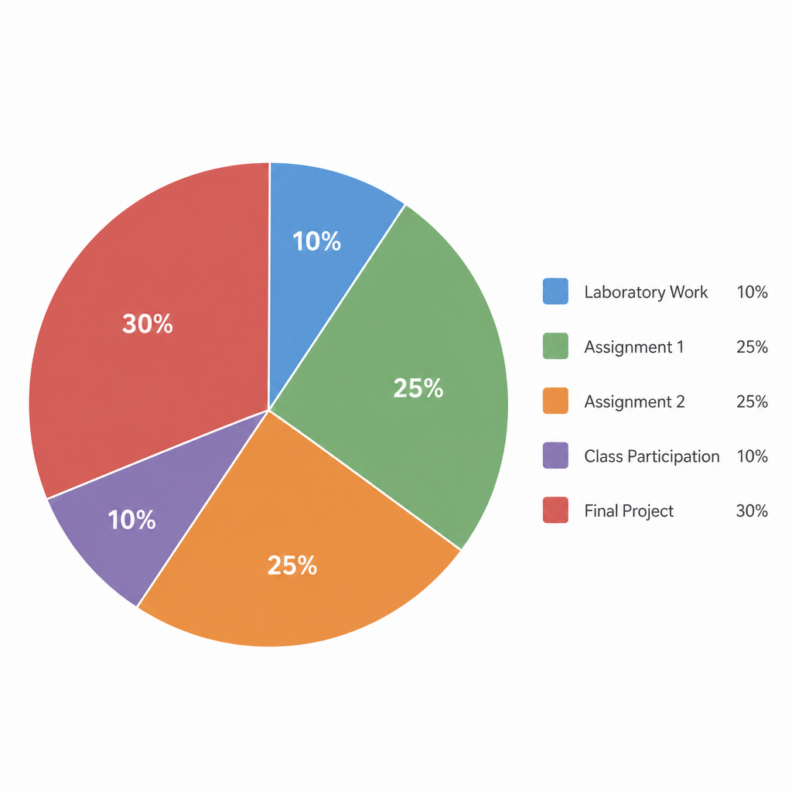
Assessment Breakdown Visualization
Laboratory Work: 10%
Assignment 1: 25%
Assignment 2: 25%
Class Participation: 10%
Final Project: 30%

Slide 12
Learning Resources & Tools
Programming Languages & Environments:
Python: Primary language (Pandas, NumPy, Matplotlib, Seaborn, Scikit-learn)
Excel: Data exploration and pivot table analysis
Recommended Tools:
Jupyter Notebook / RStudio for interactive analysis
Git/GitHub for version control
Tableau or Power BI for advanced visualization
Online Resources:
Kaggle datasets and competitions
GitHub repositories with EDA examples
Academic journals and research papers
Course learning management system (LMS)

Slide 13
Pedagogy & Teaching Approach
Instructional Methods:
Lectures: Theoretical foundations and advanced concepts (2 hours/week)
Hands-on Labs: Practical implementation and tool proficiency (4 hours/week)
Case Studies: Real-world dataset analysis and industry applications
Problem-Based Learning: Complex, open-ended exploratory challenges
Self-Learning Resources: Curated tutorials, documentation, and supplementary materials
Peer Review: Collaborative feedback on assignments and projects
Guest Lectures: Industry practitioners sharing real-world EDA experiences
Learning Environment:
Inclusive, collaborative classroom culture
Emphasis on experimentation and iterative learning
Regular feedback and formative assessment

Slide 14
References & Textbooks
Primary Textbooks:
Tukey, J. W. (1977). Exploratory Data Analysis. Addison-Wesley.
Wickham, H., & Grolemund, G. (2017). R for Data Science. O'Reilly Media.
McKinney, W. (2022). Python for Data Analysis (3rd ed.). O'Reilly Media.
Supplementary Resources:
Cleveland, W. S. (1993). Visualizing Data. Hobart Press.
Peng, R. D., & Matsui, E. (2015). The Art of Data Science. Leanpub.
Freedman, D., Pisani, R., & Purves, R. (2007). Statistics (4th ed.). W.W. Norton.
Online Journals & Conferences:
Journal of Statistical Software
IEEE Transactions on Visualization and Computer Graphics
KDD, ICML, NeurIPS proceedings

Slide 15
Course Completion & Next Steps
Upon successful completion of DATA209, students will be equipped to conduct sophisticated exploratory analyses, communicate data-driven insights, and prepare analytical datasets for advanced modeling. This course serves as a foundation for specialized electives in machine learning, statistical modeling, and data engineering.
Next Recommended Course: Machine Learning

